Slide 1

Shield insurance
Codebasics Virtual Internship Project

Slide 2

About us
This Presentation is about a Imaginary company called Shield Insurance. It is concerned offering comprehensive coverage and reliable policies to its customers. The Codebasics Team has given us to make proper Data Analysis Dashboard and to make presentation on the same to analyze it’s customer age groups and get Insights.​

Slide 3
KEY METRICS
REVENUE
Customers
The Insurance Companies earn their Revenue from the premium amounts paid by their policy holders and it’s total of 989M.
The Total customers which shows the total of around 27,000 total customers.
DRGm
DCGM
This is Daily Revenue Growth per Month which has a overall of 4.39M.
This shows the Daily Customer Growth Rate per Month which has an overall growth of 126.23%

Slide 4
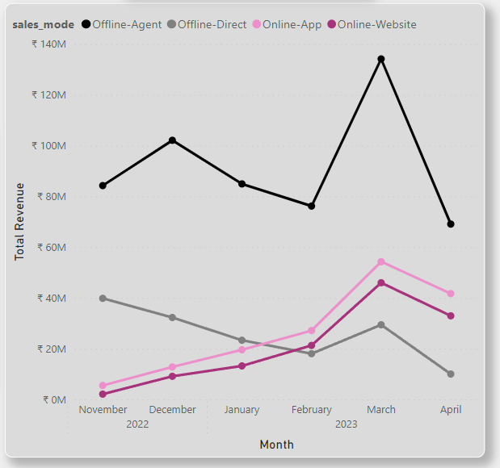
SALES MODE
Offline-Agent
The Chart shows about the Sales Mode where there is significant increase in the sales through Offline Agent Sales mode.
Online-app
Due to changes in tech and also because of in the beginning of the fiscal year the Online-App sales mode has also increased.

Slide 5
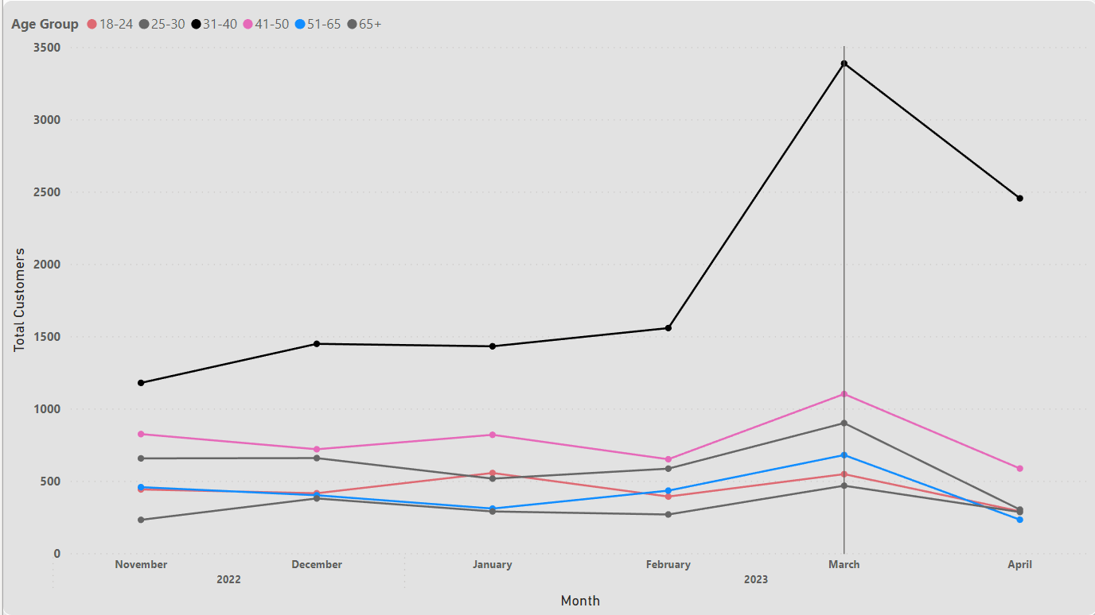
age group
Age group analysis
The Age group from between 31-40 getting more customers even before the peak month March.
The Age group from between 41-50 getting more customers even before the peak month March.

Slide 6




Solution
Customer gap
Target Age group
Although the company getting many customers at the end of the fiscal year as there are new insurances but they have to analyze things and check whether these are the actual growth in customers.
The company is getting the required target age groups but in order to keep the retention they have to take certain steps.
Cost savings
Easy to use
Reduce expenses by eliminating the need to walk-in towards offline agents​
As now there is growth in Online-Agent Sales mode it is has become easy to use for the customers.

Slide 7
Summary
At Shield, as of any Insurance Company is concerned offering comprehensive coverage and reliable policies to its customers. With a focus on customer satisfaction, Shield Insurance ensures that every individual is protected against unforeseen events. It also has to study their customers and how to satisfy them with different policies.

Slide 8

Thank you
GURUNATHA HEBBAR
GITHUB
FOLLOW me on LINKEDIN

